Slide 1



고신뢰 메모리를 위한 지능형 인메모리 오류정정 디바이스 개발
주관연구개발기관 : 서울대학교 (이혁재, 심재웅 교수)
참여기관: 성균관대학교 (김상효, 김정래, 홍석인 교수)
관악 아날로그 ㈜ (김수환 대표)
성균관대학교
김동휘
2023.08.17

Slide 2
과제 목표
Smart CXL ECC
소제목을 입력하세요.
소제목을 입력하세요.
Error correction
Erasure correction
DUE
Result
Future work

Slide 3
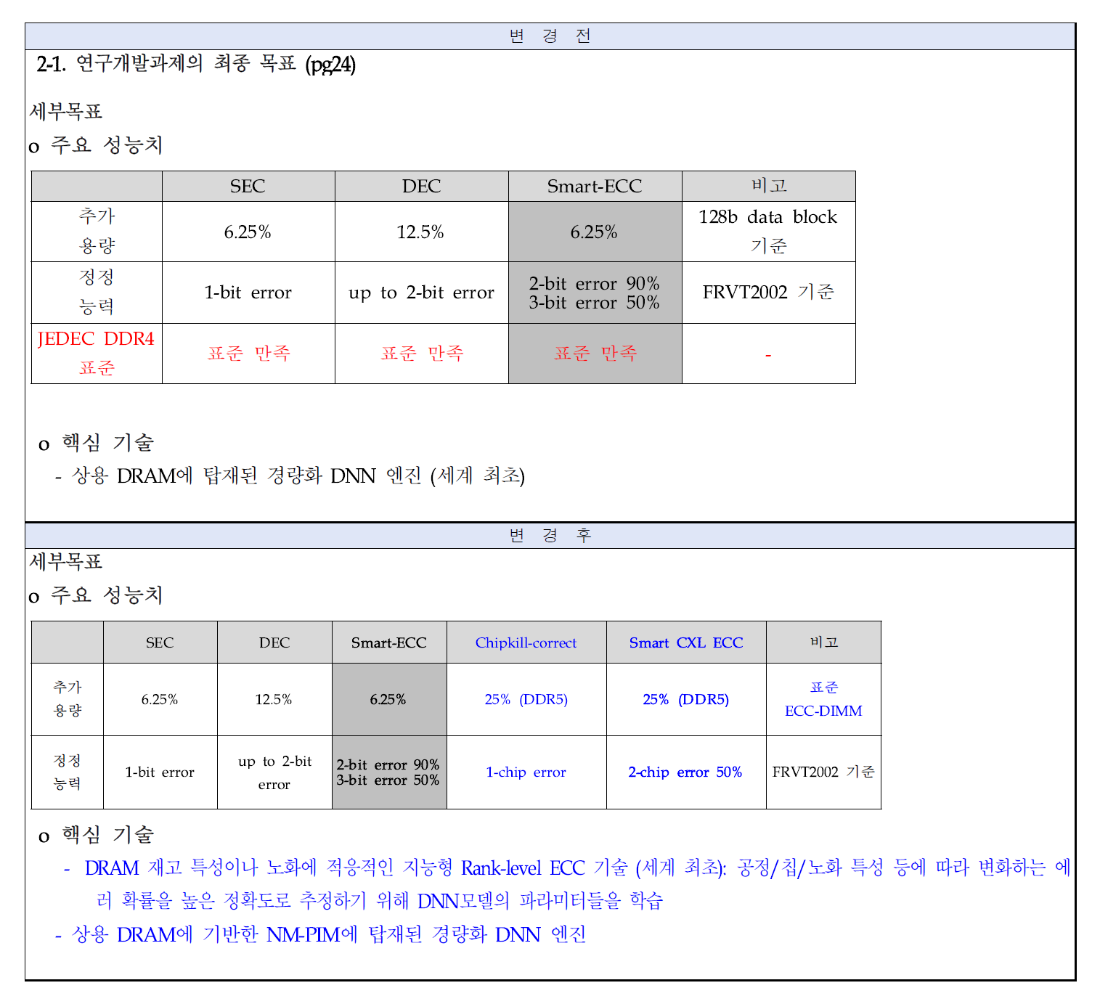
과제 목표
Smart CXL ECC (Near Data Processing)
Rank-Level ECC
1-chip error 100% correction & 2-chip error 50% correction
On-die ECC
Rank-level ECC

Slide 4
과제 목표
(136, 128) Hamming code
On-Die ECC
Correction-capability: 1 bit
Can correct 20~22% of 2-chip errors (Using ‘Alert_n’ pin)
Can correct almost 90% of 2-chip errors (Dominant multi-bit error cases)
DBE+DBE (Double bit Error + Double bit Error)

Slide 5
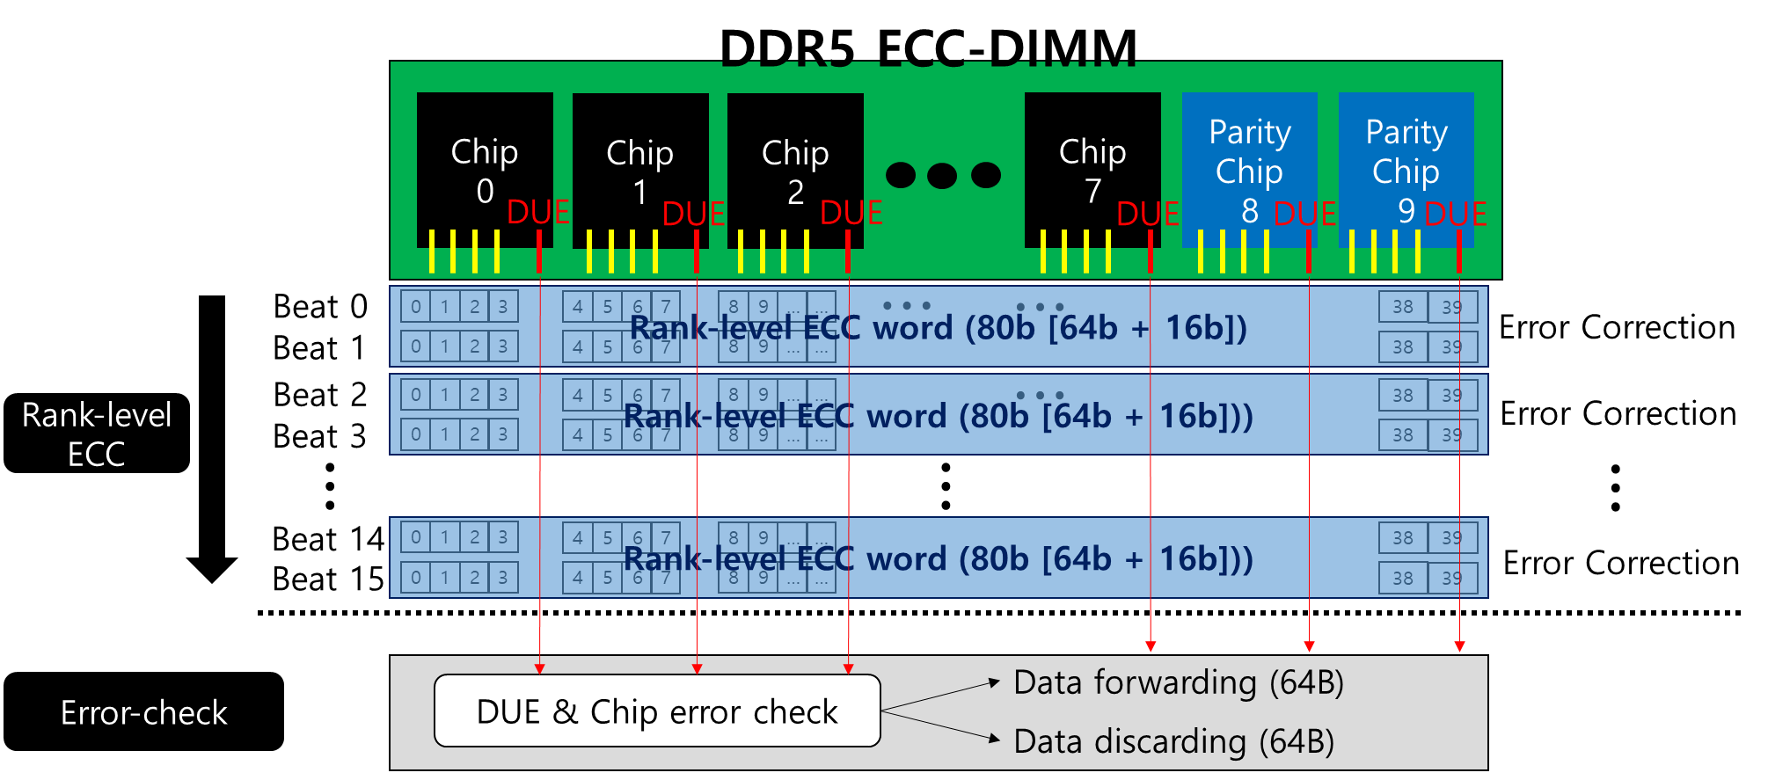
Smart CXL ECC
Smart CXL ECC (Near Data Processing)
Error correction: 1-chip error correction
Erasure correction: 2-chip error correction
Memory
transfer block

Slide 6
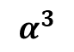

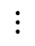
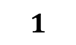
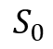
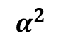
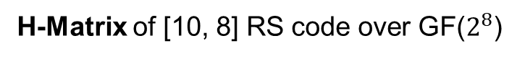

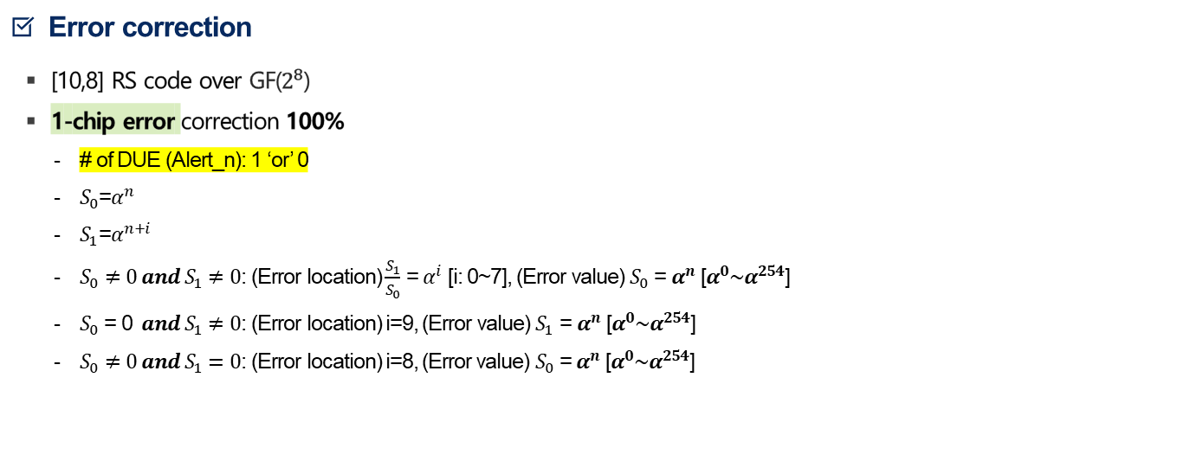
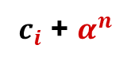
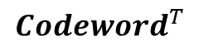
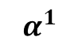

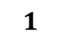

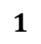
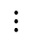
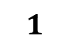
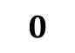

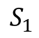
Smart CXL ECC
Error correction
[10,8] RS code over GF($2^{8}$)
1-chip error correction 100%
# of DUE (Alert_n): 1 ‘or’ 0
$S_{0}$=$α^{n}$
$S_{1}$=$α^{n+i}$
$S_{0}≠0 and S_{1}≠0$: (Error location) $\frac{S_{1}}{S_{0}}$ = $α^{i}$ [i: 0~7], (Error value) $S_{0}$ = $α^{n}$ [$α^{0}\sim α^{254}$]
$S_{0}$ = 0 $and S_{1}≠0$: (Error location) i=9, (Error value) $S_{1}$ = $α^{n}$ [$α^{0}\sim α^{254}$]
$S_{0}≠0 and S_{1}=0$: (Error location) i=8, (Error value) $S_{0}$ = $α^{n}$ [$α^{0}\sim α^{254}$]
$$c_{0}$$
$$c_{1}$$
Error location
$$c_{2}$$
Error value
$$1$$
$$1$$
$$1$$
1
…
1
0
$$⋮$$
$$S_{0}$$
$c_{i}$ + $α^{n}$
$$1$$
$$α^{1}$$
$$α^{2}$$
$$α^{3}$$
…
$$0$$
$$1$$
$$S_{1}$$
$$⋮$$
H-Matrix of [10, 8] RS code over GF($2^{8}$)
$$c_{9}$$
Syndromes
$${Codeword}^{T}$$

Slide 7
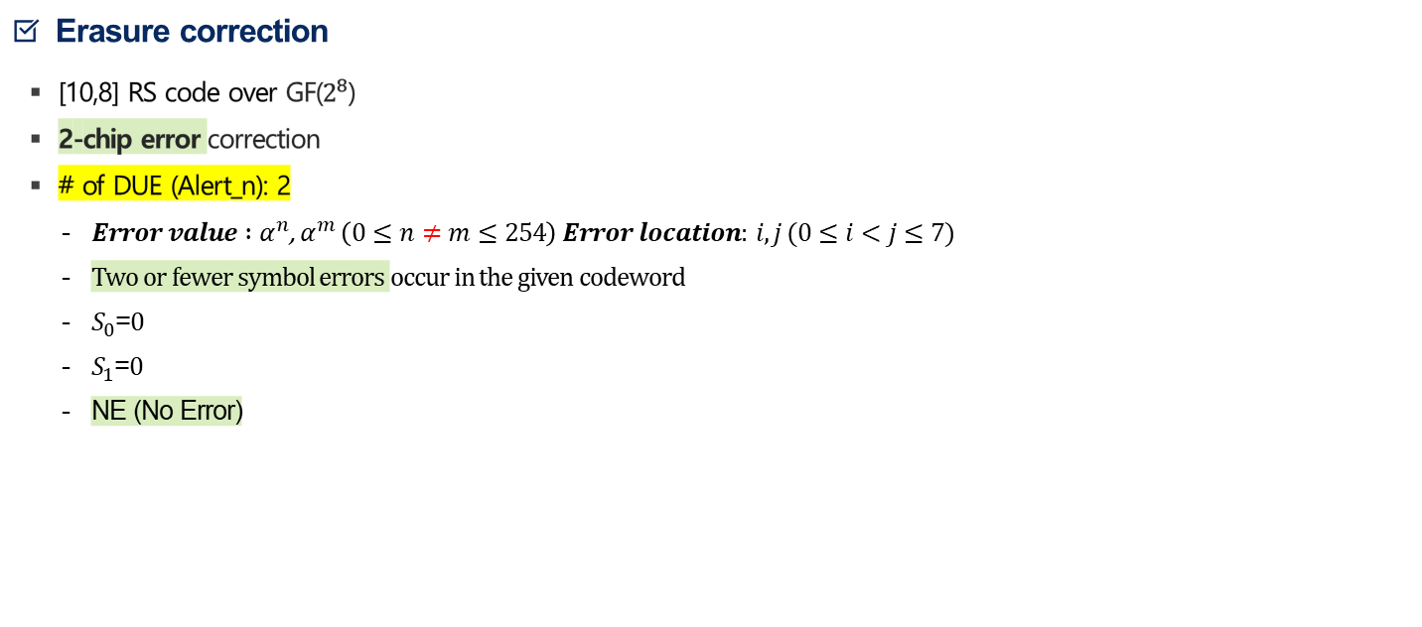
Smart CXL ECC
Erasure correction
[10,8] RS code over GF($2^{8}$)
2-chip error correction
# of DUE (Alert_n): 2
$Error value :α^{n}$, $α^{m} \left(0≤n≠m≤254\right) Error location: i,j (0≤i<j≤7)$
Two or fewer symbol errors occur in the given codeword
$S_{0}$=$0$
$S_{1}$=$0$
NE (No Error)
$$c_{0}$$
$$c_{1}$$
Error location
$$c_{2}$$
Error value
$$1$$
$$1$$
$$1$$
1
…
1
0
$$⋮$$
$$S_{0}$$
$c_{i}$ + $α^{n}$
$$1$$
$$α^{1}$$
$$α^{2}$$
$$α^{3}$$
…
$$0$$
$$1$$
$$⋮$$
$$S_{1}$$
$c_{j}$ + $α^{m}$
$$⋮$$
Syndromes
H-Matrix of [10, 8] RS code over GF($2^{8}$)
$$c_{9}$$
$${Codeword}^{T}$$

Slide 8
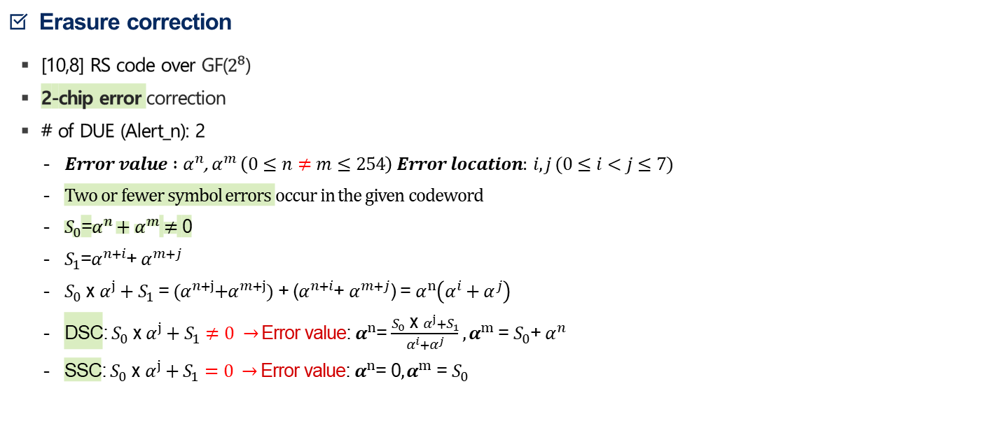
Smart CXL ECC
Erasure correction
[10,8] RS code over GF($2^{8}$)
2-chip error correction
# of DUE (Alert_n): 2
$Error value :α^{n}$, $α^{m} \left(0≤n≠m≤254\right) Error location: i,j (0≤i<j≤7)$
Two or fewer symbol errors occur in the given codeword
$S_{0}$=$α^{n}+α^{m}$ $≠$ 0
$S_{1}$=$α^{n+i}$+ $α^{m+j}$
$S_{0}$ x $α^{j}+S_{1}$ = ${(α}^{n+j}+α^{m+j})$ + ($α^{n+i}$+ $α^{m+j}$) = $α^{n}\left(α^{i}+α^{j}\right)$
DSC: $S_{0}$ x $α^{j}+S_{1}$ $≠0 →$Error value: $α^{n}$= $\frac{S_{0} \text{x} α^{j}+S_{1}}{α^{i}+α^{j}}{, α}^{m}$ = $S_{0}$+ $α^{n}$
SSC: $S_{0}$ x $α^{j}+S_{1}=0 →$Error value: $α^{n}$= 0${, α}^{m}$ = $S_{0}$
$$c_{0}$$
$$c_{1}$$
Error location
$$c_{2}$$
Error value
$$1$$
$$1$$
$$1$$
1
…
1
0
$$⋮$$
$$S_{0}$$
$c_{i}$ + $α^{n}$
$$1$$
$$α^{1}$$
$$α^{2}$$
$$α^{3}$$
…
$$0$$
$$1$$
$$⋮$$
$$S_{1}$$
$c_{j}$ + $α^{m}$
$$⋮$$
Syndromes
H-Matrix of [10, 8] RS code over GF($2^{8}$)
$$c_{9}$$
$${Codeword}^{T}$$

Slide 9
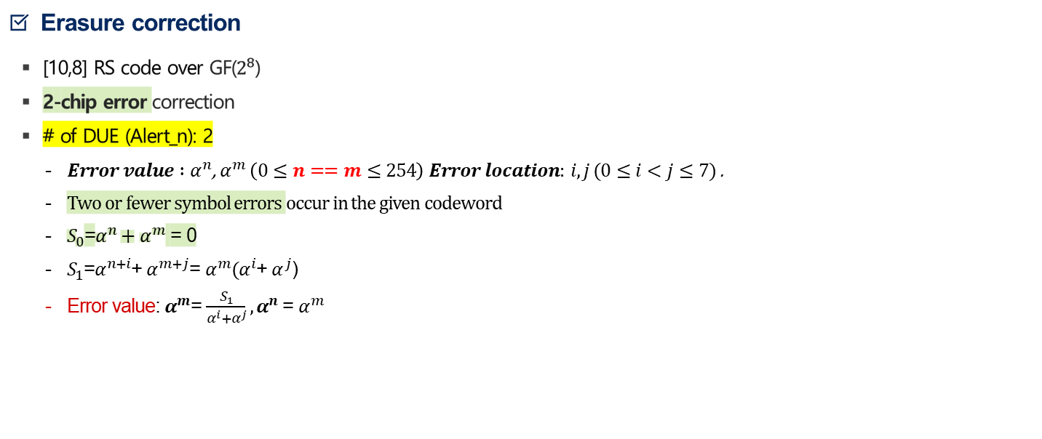
Smart CXL ECC
Erasure correction
[10,8] RS code over GF($2^{8}$)
2-chip error correction
# of DUE (Alert_n): 2
$Error value :α^{n}$, $α^{m} \left(0≤n==m≤254\right) Error location: i,j (0≤i<j≤7)$ .
Two or fewer symbol errors occur in the given codeword
$S_{0}$=$α^{n}+α^{m}$ = 0
$S_{1}$=$α^{n+i}$+ $α^{m+j}$= $α^{m}(α^{i}$+ $α^{j}$)
Error value: $α^{m}$= $\frac{S_{1}}{α^{i}+α^{j}}{, α}^{n}$ = $α^{m}$
$$c_{0}$$
$$c_{1}$$
Error location
$$c_{2}$$
Error value
$$1$$
$$1$$
$$1$$
1
…
1
0
$$⋮$$
$$S_{0}$$
$c_{i}$ + $α^{n}$
$$1$$
$$α^{1}$$
$$α^{2}$$
$$α^{3}$$
…
$$0$$
$$1$$
$$⋮$$
$$S_{1}$$
$c_{j}$ + $α^{m}$
$$⋮$$
Syndromes
H-Matrix of [10, 8] RS code over GF($2^{8}$)
$$c_{9}$$
$${Codeword}^{T}$$

Slide 10
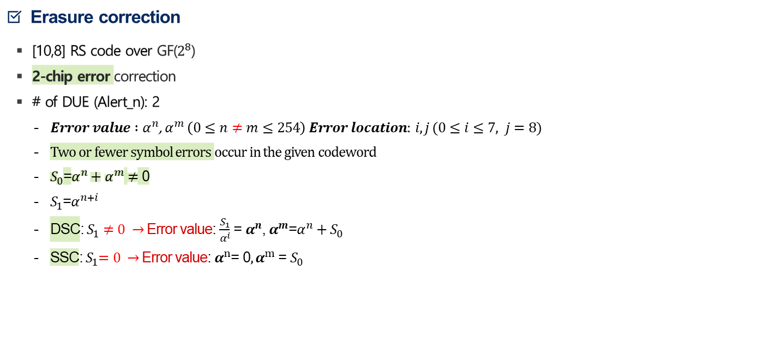
Smart CXL ECC
Erasure correction
[10,8] RS code over GF($2^{8}$)
2-chip error correction
# of DUE (Alert_n): 2
$Error value :α^{n}$, $α^{m} \left(0≤n≠m≤254\right) Error location: i,j (0≤i≤7, j=8)$
Two or fewer symbol errors occur in the given codeword
$S_{0}$=$α^{n}+α^{m}$ $≠$ 0
$S_{1}$=$α^{n+i}$
DSC: $S_{1}$ $≠0 →$Error value: $\frac{S_{1}}{α^{i}}$ = $α^{n}$, $α^{m}$=$α^{n}+S_{0}$
SSC:${ S}_{1}=0 →$Error value: $α^{n}$= 0${, α}^{m}$ = $S_{0}$
$$c_{0}$$
$$c_{1}$$
Error location
$$c_{2}$$
Error value
$$1$$
$$1$$
$$1$$
1
…
1
0
$$⋮$$
$$S_{0}$$
$c_{i}$ + $α^{n}$
$$1$$
$$α^{1}$$
$$α^{2}$$
$$α^{3}$$
…
$$0$$
$$1$$
$$⋮$$
$$S_{1}$$
$c_{j}$ + $α^{m}$
$$⋮$$
Syndromes
H-Matrix of [10, 8] RS code over GF($2^{8}$)
$$c_{9}$$
$${Codeword}^{T}$$

Slide 11
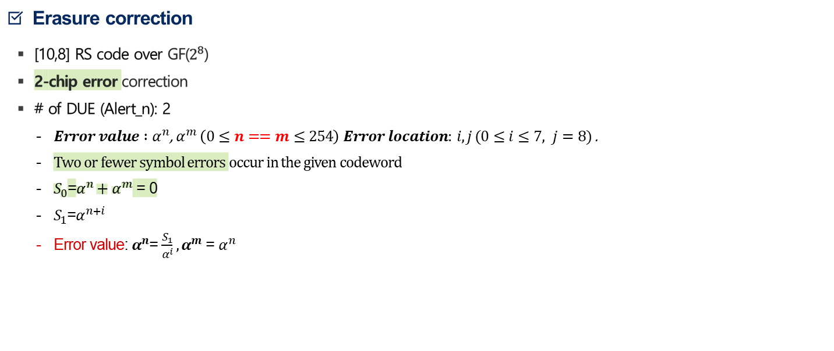
Smart CXL ECC
Erasure correction
[10,8] RS code over GF($2^{8}$)
2-chip error correction
# of DUE (Alert_n): 2
$Error value :α^{n}$, $α^{m} \left(0≤n==m≤254\right) Error location: i,j (0≤i≤7, j=8)$ .
Two or fewer symbol errors occur in the given codeword
$S_{0}$=$α^{n}+α^{m}$ = 0
$S_{1}$=$α^{n+i}$
Error value: $α^{n}$= $\frac{S_{1}}{α^{i}}{, α}^{m}$ = $α^{n}$
$$c_{0}$$
$$c_{1}$$
Error location
$$c_{2}$$
Error value
$$1$$
$$1$$
$$1$$
1
…
1
0
$$⋮$$
$$S_{0}$$
$c_{i}$ + $α^{n}$
$$1$$
$$α^{1}$$
$$α^{2}$$
$$α^{3}$$
…
$$0$$
$$1$$
$$⋮$$
$$S_{1}$$
$c_{j}$ + $α^{m}$
$$⋮$$
Syndromes
H-Matrix of [10, 8] RS code over GF($2^{8}$)
$$c_{9}$$
$${Codeword}^{T}$$

Slide 12
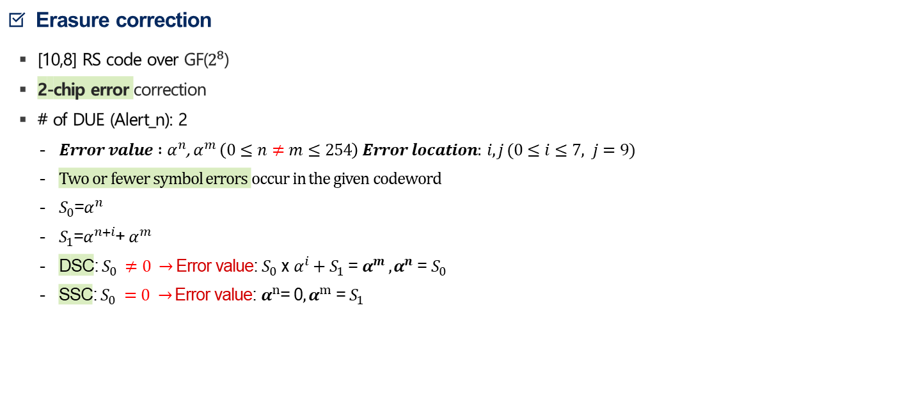
Smart CXL ECC
Erasure correction
[10,8] RS code over GF($2^{8}$)
2-chip error correction
# of DUE (Alert_n): 2
$Error value :α^{n}$, $α^{m} \left(0≤n≠m≤254\right) Error location: i,j (0≤i≤7, j=9)$
Two or fewer symbol errors occur in the given codeword
$S_{0}$=$α^{n}$
$S_{1}$=$α^{n+i}$+ $α^{m}$
DSC: $S_{0} ≠0 →$Error value: $S_{0}$ x $α^{i}+S_{1}$ = $α^{m} {, α}^{n}$ = $S_{0}$
SSC: $S_{0} =0 →$Error value: $α^{n}$= 0${, α}^{m}$ = $S_{1}$
$$c_{0}$$
$$c_{1}$$
Error location
$$c_{2}$$
Error value
$$1$$
$$1$$
$$1$$
1
…
1
0
$$⋮$$
$$S_{0}$$
$c_{i}$ + $α^{n}$
$$1$$
$$α^{1}$$
$$α^{2}$$
$$α^{3}$$
…
$$0$$
$$1$$
$$⋮$$
$$S_{1}$$
$c_{j}$ + $α^{m}$
$$⋮$$
Syndromes
H-Matrix of [10, 8] RS code over GF($2^{8}$)
$$c_{9}$$
$${Codeword}^{T}$$

Slide 13
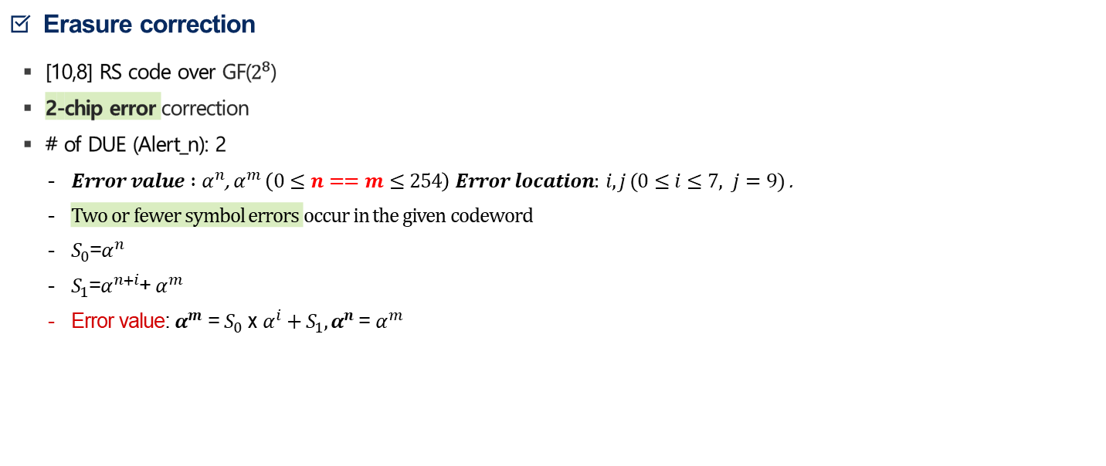
Smart CXL ECC
Erasure correction
[10,8] RS code over GF($2^{8}$)
2-chip error correction
# of DUE (Alert_n): 2
$Error value :α^{n}$, $α^{m} \left(0≤n==m≤254\right) Error location: i,j (0≤i≤7, j=9)$ .
Two or fewer symbol errors occur in the given codeword
$S_{0}$=$α^{n}$
$S_{1}$=$α^{n+i}$+ $α^{m}$
Error value: $α^{m}$ = $S_{0}$ x $α^{i}+S_{1}{, α}^{n}$ = $α^{m}$
$$c_{0}$$
$$c_{1}$$
Error location
$$c_{2}$$
Error value
$$1$$
$$1$$
$$1$$
1
…
1
0
$$⋮$$
$$S_{0}$$
$c_{i}$ + $α^{n}$
$$1$$
$$α^{1}$$
$$α^{2}$$
$$α^{3}$$
…
$$0$$
$$1$$
$$⋮$$
$$S_{1}$$
$c_{j}$ + $α^{m}$
$$⋮$$
Syndromes
H-Matrix of [10, 8] RS code over GF($2^{8}$)
$$c_{9}$$
$${Codeword}^{T}$$

Slide 14
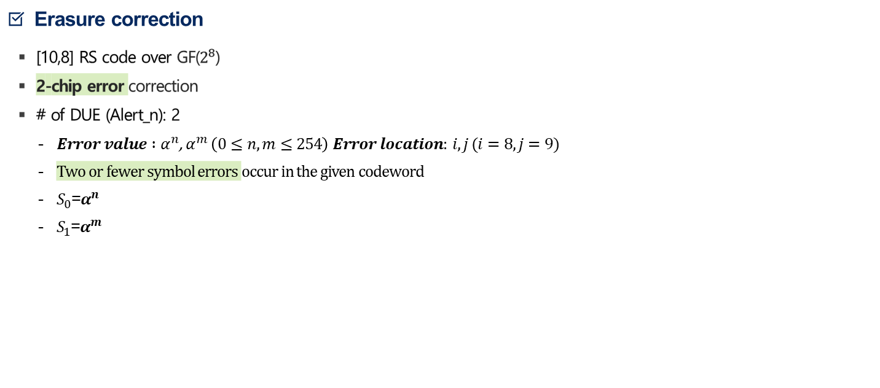
Smart CXL ECC
Erasure correction
[10,8] RS code over GF($2^{8}$)
2-chip error correction
# of DUE (Alert_n): 2
$Error value :α^{n}$, $α^{m} \left(0≤n,m≤254\right) Error location: i,j (i=8, j=9)$
Two or fewer symbol errors occur in the given codeword
$S_{0}$=$α^{n}$
$S_{1}$=$α^{m}$
$$c_{0}$$
$$c_{1}$$
Error location
$$c_{2}$$
Error value
$$1$$
$$1$$
$$1$$
1
…
1
0
$$⋮$$
$$S_{0}$$
$c_{i}$ + $α^{n}$
$$1$$
$$α^{1}$$
$$α^{2}$$
$$α^{3}$$
…
$$0$$
$$1$$
$$⋮$$
$$S_{1}$$
$c_{j}$ + $α^{m}$
$$⋮$$
Syndromes
H-Matrix of [10, 8] RS code over GF($2^{8}$)
$$c_{9}$$
$${Codeword}^{T}$$

Slide 15
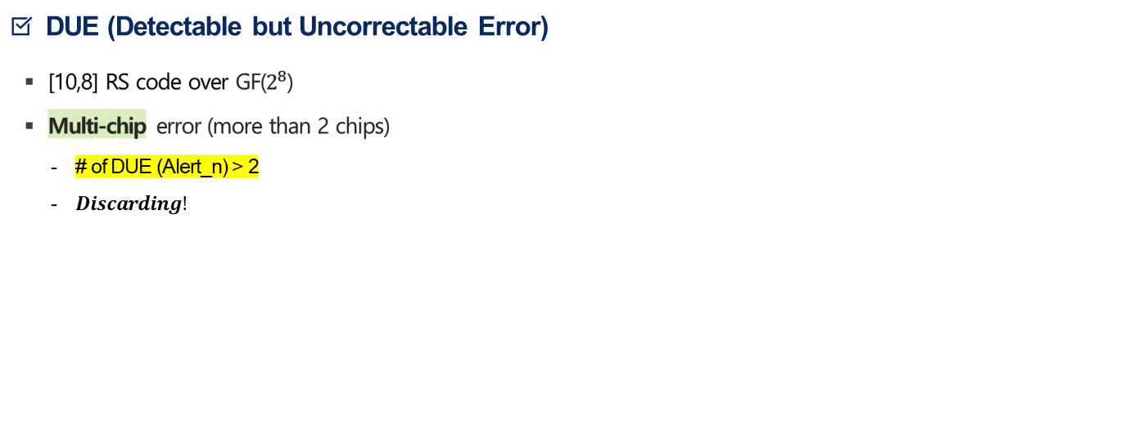
Smart CXL ECC
DUE (Detectable but Uncorrectable Error)
[10,8] RS code over GF($2^{8}$)
Multi-chip error (more than 2 chips)
# of DUE (Alert_n) > 2
$Discarding!$

Slide 16
Smart CXL ECC
Block diagram
Selector: DUE [Alert_n]
# of DUE > 2 -> DUE
# of DUE: 2 -> Erasure decoder
# of DUE: 1 -> Error decoder
# of DUE: 0 -> Error decoder
Block diagram
80b
Error
Decoder
64b
Codeword (80b)
80b
DEMUX
64b
Data
(64b)
MUX
80b
Erasure
Decoder
64b
DUE 0~9
DUE 0~9

Slide 17
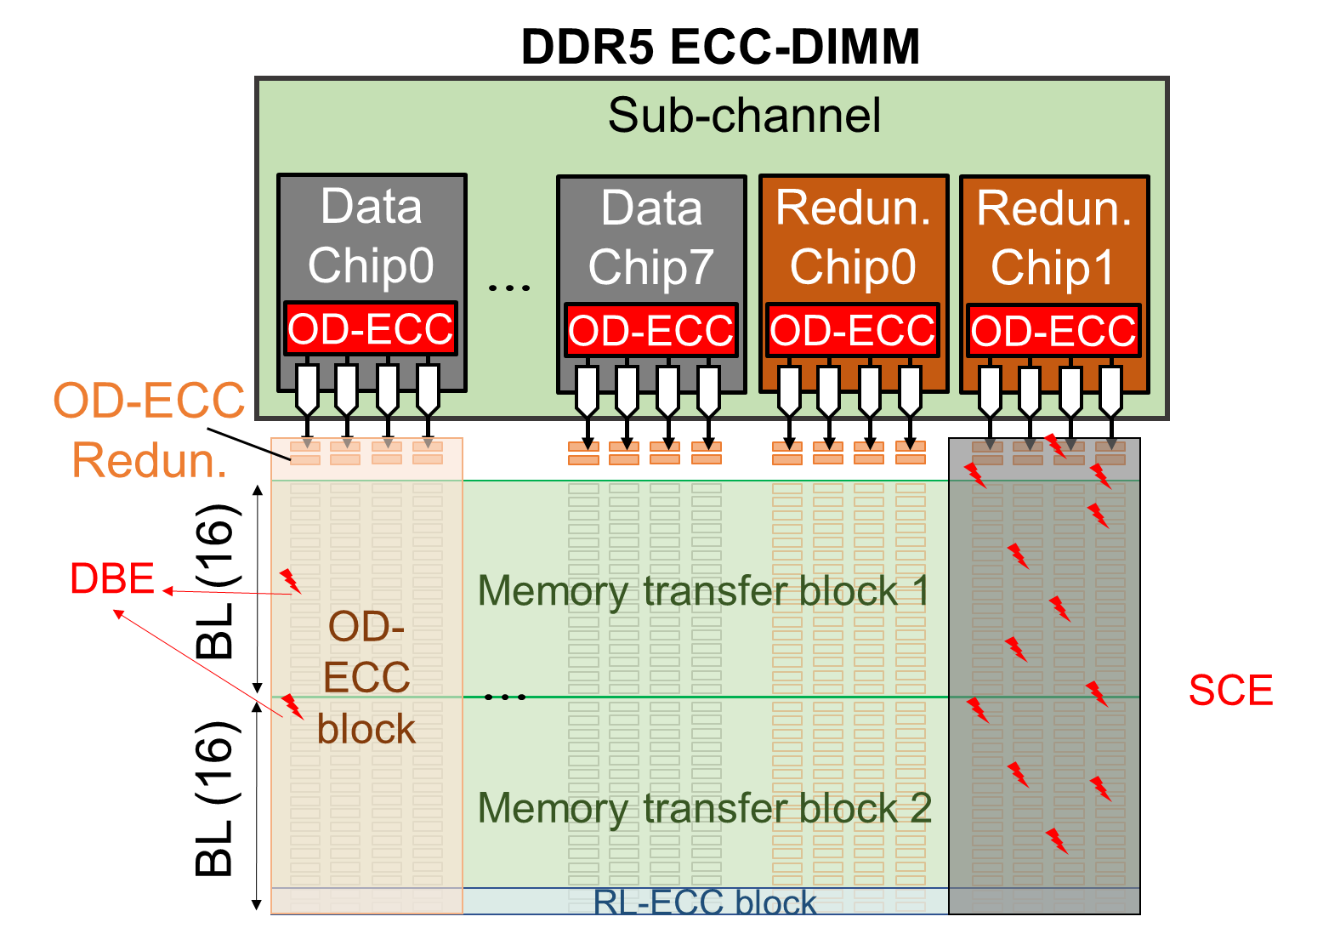
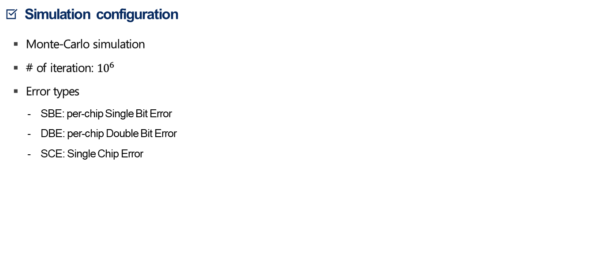
Result
Simulation configuration
Monte-Carlo simulation
# of iteration: ${10}^{6}$
Error types
SBE: per-chip Single Bit Error
DBE: per-chip Double Bit Error
SCE: Single Chip Error
OD-ECC: On-Die ECC (136, 128)
RL-ECC: Rank-level ECC

Slide 18
Result
Result
Monte-Carlo simulation
SEC
RS erasure decoding
 | ECC Result | SEC + Chipkill | Smart ECC + Smart CXL ECC
SBE | CE | 100% | 100%
DBE | CE | 100% | 100%
SCE | CE | 100% | 100%
SBE+SBE | CE | 100% | 100%
SBE+DBE | CE | 100% | 100%
SBE+SCE | CE | 100% | 100%
DBE+DBE | CE DUE SDC | 13.48% 85.42% 1.10% | 90.77% 8.80% 0.43%
DBE+SCE | CE DUE SDC | 0.28% 96.52% 3.20% | 38.92% 59.15% 1.93%
SCE+SCE | CE DUE SDC | 0% 100% 0% | 21.60% 78.40% 0%
1 Chip error 100% correction
2 Chip erasure
correction

Slide 19
Future work
Simple/Smart ECC
On-Die ECC
(136, 128) SEC code can correct 20~22% of 2-chip error
(542, 512) TEC code can correct 90%~ of 2-chip error
Satisfy the performance metric

Slide 20
감사합니다.
Q&A

Slide 21
템플릿 사용 가이드
1. 수정되지 않는 글자, 이미지(로고)를 수정하는 방법
[상단 메뉴바] → [보기] → [슬라이드마스터] 로 들어가서 편집
2. 컬러팔레트
원색계열
#072A60 | #15738D | #086FB8 | #1895C2 | #8DC63F
파스텔계열
#B1CEF9 | #ACE1F5 | #9DD4FB | #DAEDC1 | #D9D9D9
3. 글자 강조 밑줄 적용하는 방법
[기존에 밑줄 적용된 글자를 드래그] → [서식복사 단축키 누르기(Ctrl + Shift + C)] → [밑줄 적용하고 싶은 글자를 드래그] → [ 서식붙여넣기 단축키 누르기(Ctrl + Shift + V)]

